Slide 1

Jai Jesus Khuda
PVG COET - PUNE
FE IT 2022-23 Sem - II
Progress Review - 1
Indoor Navigation System &
Parking Spot Finder
02/06/2023
PROJECT TIMELINE

Slide 2

Group Members
FE IT 2022-23 Sem II
3009 – Sudesh Bansode
3012 – Varad Chaskar
3026 – Shruti Kulkarni
3010 – Shravani Joshi
3018 – Samruddhi Garge
3027 – Asmita Yenge
Group 4
2
Swapnil Patil

Slide 3
PROMBLEM DEFINITION
Indoor Navigation
Problem Definition:
The indoor navigation problem refers to the challenge of guiding individuals or autonomous systems through complex indoor environments, such as shopping malls, airports, hospitals, or office buildings.
Large campuses can be complex to navigate, especially for newcomers.
Unlike outdoor navigation, indoor environments lack the availability of GPS signals, making it difficult to rely on traditional navigation methods

Slide 4
Parking Spot Finder Problem Definition
The parking spot finder problem involves the task of locating available parking spaces within a specific area, such as a parking garage, parking lot, or urban street parking.
This problem aims to address the challenge of limited parking availability and the time-consuming process of manually searching for vacant parking spots.

Slide 5
PROBLEM IDENTIFICATION
Indoor Navigation
Problem Identification
Individuals with disabilities or special requirements may face additional challenges in indoor navigation, such as finding accessible routes, elevators, or facilities tailored to their needs.
Indoor navigation needs to consider various obstacles such as walls, furniture, escalators, and crowds of people. Moreover, indoor environments are dynamic, with changes in furniture arrangements, temporary barriers, or ongoing renovations, making it challenging to maintain up-to-date navigation information.

Slide 6
Parking Spot Finder Problem Definition
Finding an available parking spot can be a time-consuming task, especially in busy areas, crowded parking lots, or during peak hours. The lack of real-time information on parking spot availability can lead to frustration and wasted time for drivers.
Poor parking space management and utilization can result in congested parking lots, inefficient use of space, and difficulties in finding vacant spots. This can lead to increased traffic, wasted fuel, and environmental impact.
Drivers with specific requirements, such as accessible parking spots, electric vehicle charging stations, or larger parking spaces for oversized vehicles, face difficulties in identifying suitable parking options that meet their needs.

Slide 7
Indoor Navigation
SCOPE
OBJECTIVES
Indoor navigation systems can be designed for a wide range of indoor environments, including shopping malls, airports, hospitals, office buildings, universities, and more
The scope includes providing real-time navigation guidance, considering factors such as obstacles, floor plans, points of interest, and efficient route planning within the indoor environment.
Indoor navigation solutions can be developed for various user groups, including individuals, groups, and autonomous systems like robots or drones.
Develop accurate and reliable indoor positioning systems that can compensate for the lack of GPS signals and provide precise location information within indoor environments.
Provide users with real-time navigation guidance, displaying optimal routes, points of interest, and relevant information to facilitate efficient and seamless navigation.
Improve user experience by reducing confusion, minimizing travel time, and enhancing overall satisfaction in navigating complex indoor environments.

Slide 8
Parking Spot Finder
SCOPES
OBJECTIVE
The scope encompasses various types of parking areas, including parking garages, parking lots, on-street parking, and designated parking zones in urban areas.
Integration with sensors, cameras, or other technologies can be explored to monitor parking spot availability and provide real-time updates.
Solutions can be designed for both individual drivers and parking facility operators, offering benefits such as improved parking efficiency, reduced congestion, and revenue optimization.
Develop a reliable and user-friendly system that enables drivers to quickly locate available parking spots, reducing the time spent searching for parking.
Provide real-time updates on parking spot availability to improve parking efficiency and reduce congestion in parking facilities and urban areas.
Enhance the user experience by offering additional information such as parking rates, time restrictions, and amenities associated with parking spots.

Slide 11
Need of Project
FE IT 2022-23 Sem II
1. Efficient navigation: Large campuses can be complex to navigate, especially for newcomers. A campus navigation system can provide turn-by-turn directions, maps, and real-time guidance to help individuals reach their desired destinations quickly and easily. It can include information about buildings, departments, classrooms, libraries, recreational facilities, and other important locations on campus.
2. Time-saving: Finding parking spots can be a significant challenge on crowded campuses, leading to wasted time and frustration. A parking spot finder integrated into the navigation system can help users locate available parking areas or specific parking spots, reducing the time spent searching for parking. This feature can save valuable time, especially during peak hours or when events are taking place on campus.
3. Accessibility: Campus navigation systems can offer accessibility features, such as wheelchair-accessible routes, elevator locations, and ramps. This helps individuals with mobility challenges navigate the campus more easily and promotes inclusivity for people with disabilities.
4. Reduced congestion: By providing real-time information on available parking spots, the system can help reduce traffic congestion caused by drivers circling around in search of parking. This can lead to a smoother traffic flow on campus and a decrease in carbon emissions from idle vehicles.
5. Enhanced visitor experience: Visitors to a campus, such as prospective students, parents, guest lecturers, or conference attendees, often face the additional challenge of unfamiliarity with the campus layout. A navigation system can provide a positive and welcoming experience by helping visitors navigate the campus efficiently and find appropriate parking.
3

Slide 12

Parking
1
Parking
2
Parking
3
Block Diagram
Client 2
FE IT 2022-23 Sem II
Parking Spot Finder
GPS Satellite
Database
Mobile Application
Network
Navigation System
Client 1
Cloud
Cloud Database
Network
4
Mobile Application

Slide 13
Algorithm
Step 1 : Start
Step 2: Choose a Service from Main Menu
Step 3 : If service==navigation
Algorithm Part 2 – Navigation System
else
Algorithm Part 3 – Parking Finder
Step 4 : End Navigation System Step 1 : Start
Step 2 : Choose a destination from the Menu
Step 3 : Determine the location of user using GPS or Manual Input
Step 4 : Fetch the shortest pathway to the desired location from the server
Step 5 : Display the pathway
Step 6 : Direct the user to the desired location Step 7 : End Parking Spot Finder Step 1 : Start
Step 2 : Choose Vehicle Type from the Menu
Step 3 : Reserve a parking space which supports the Vehicle type
Step 4 : Direct the client to the reserved parking space
Step 5 : Record the vehicle leaving
Step 6 : Free the parking spot for other vehicles Step 7 : End
FE IT 2022-23 Sem II
5

Slide 14
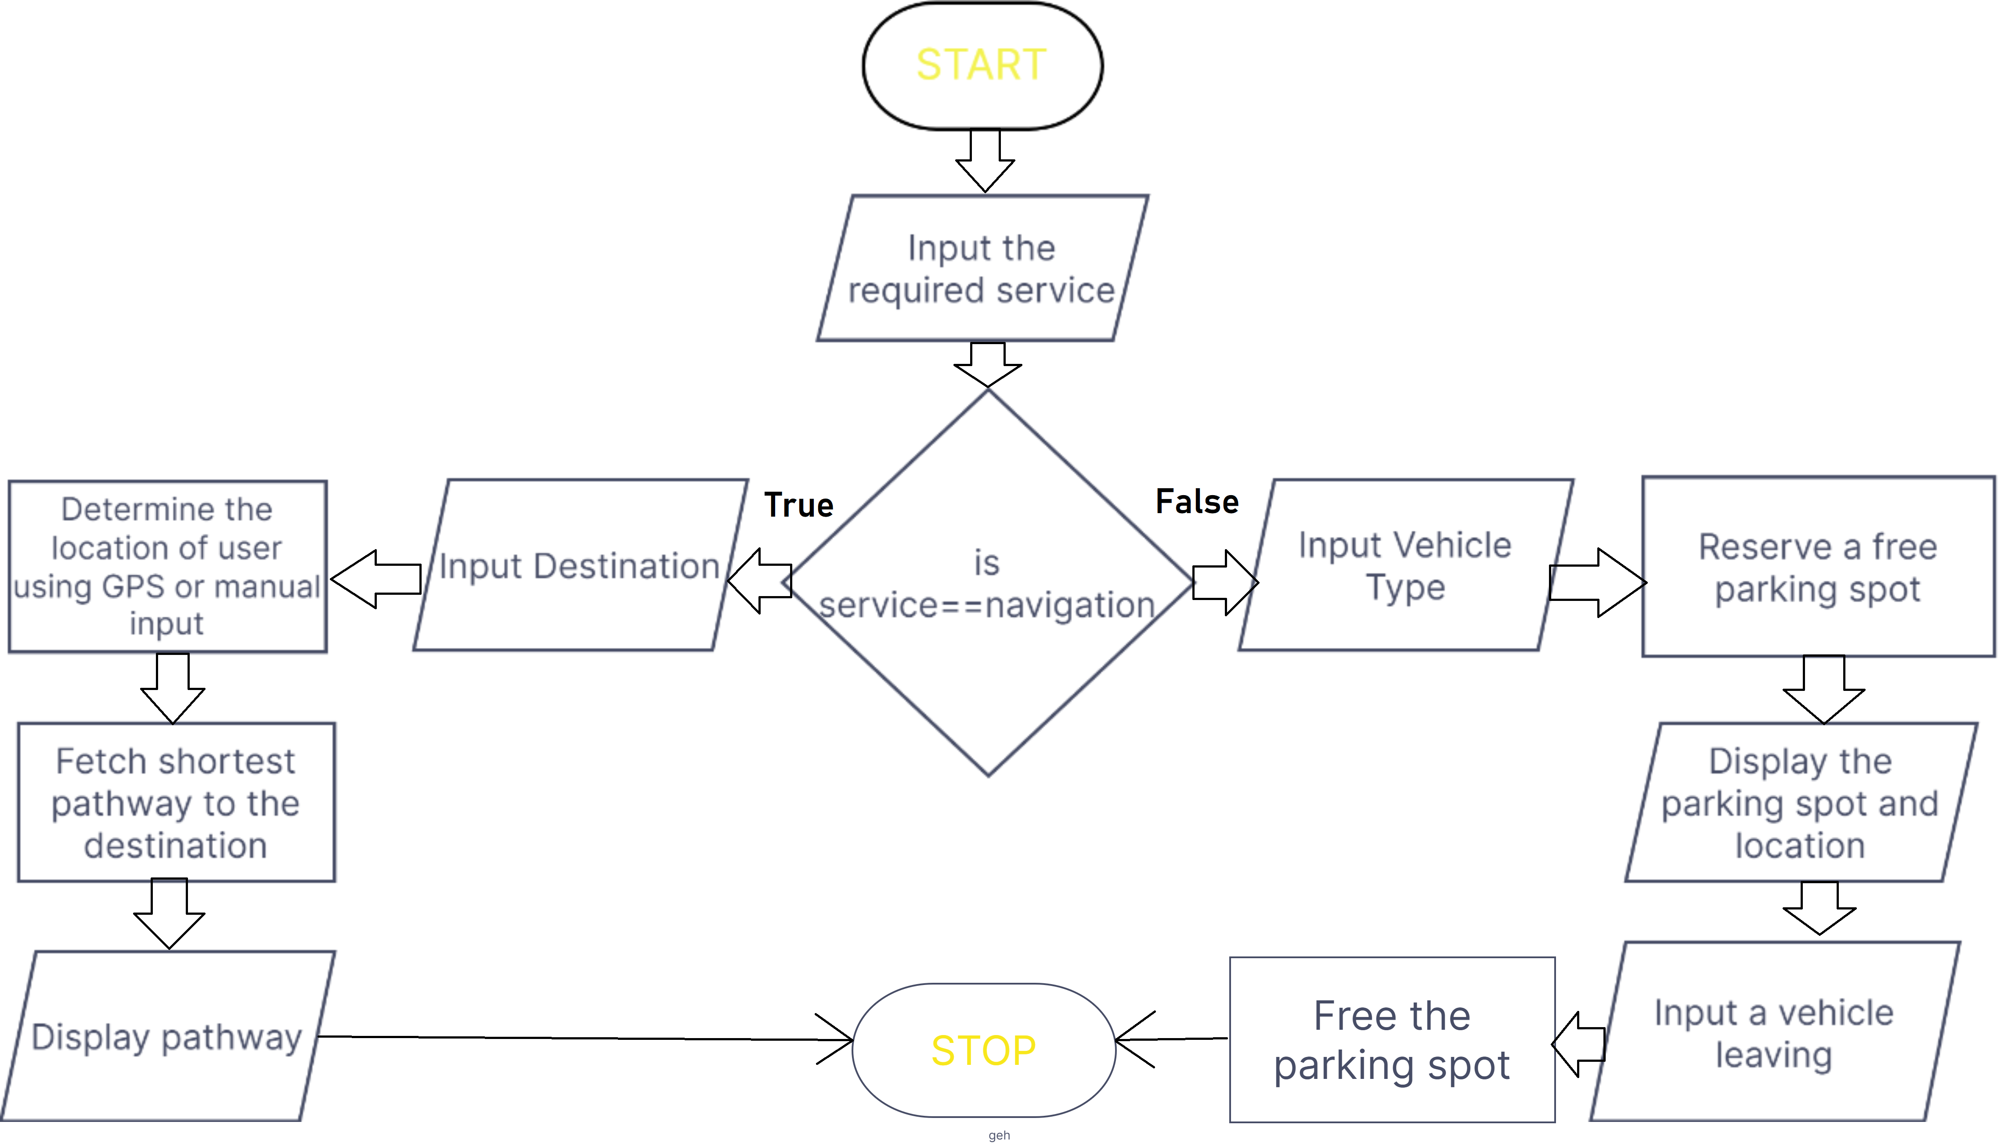
Flow Chart
FE IT 2022-23 Sem II
6

Slide 15

Thank you!
FE IT 2022-23 Sem II
7

